Slide 1
Introduction to Data Communications (CMP 206)
Compiled by
Egena Onu, Ph.D.

Slide 2
Introduction
A system of interconnected computers and computerised peripherals such as printers is called a network.
The interconnection among computers facilitates information sharing.
Computers may connect to one another by either wired or wireless media.
Notes:
27/05/2021

Slide 3
Classification of Computer Networks
Computer networks are classified based on various factors:
Geographical span.
Inter-connectivity
Administration
Architecture

Slide 4
Geographical Span
Geographically, a network can be viewed in the following categories:
It may be spanned across a table, among Bluetooth enabled devices covering a few meters
It may be spanned across an entire building, including intermediate devices to connect all floors.
It may be spanned to cover a city.
It may be one network covering the whole world.

Slide 5
Inter-Connectivity
Components of a network can be connected to each other differently in some fashion.
Connected means either logically, physically, or both ways.
Every single device can be connected to every other device on the network to create a mesh.
All devices can be connected to a single medium but geographically disconnected to create a bus-like structure.

Slide 6
Inter-Connectivity
All devices are connected together to create a star-like structure.
All devices connected arbitrarily using all previous ways to connect each other thereby resulting in a hybrid structure.

Slide 7
Administration
From an administrator’s point of view, a network can be private or public.
A private network is a network that belongs to a single autonomous system and cannot be accessed outside its physical or logical domain.
A public network is one which is accessible to everyone.

Slide 8
Network Architecture
Computer networks can be defined based on different architectures such as client-server, point-to-point and hybrid.
Client-Server: is one in which two or more computers are connected with one being the client and the other acts as the sever. The clients request services from the server who in response, provide such services if they are available,

Slide 9
Network Architecture
Point-to-Point: in this network, systems are connected in a point-to-point fashion. These systems reside on the same level and are called peers.
Hybrid: a hybrid architecture involves the connections that utilises both architectures described earlier.

Slide 10
Network Applications
Computer systems and peripherals are connected to form a network that provide numerous advantages such as:
Resource sharing such as printers and storage devices.
Exchange of information through e-mails and FTP.
Interaction with other users using dynamic web pages.
IP Phones
Video conferencing
Parallel computing
Instant messaging.

Slide 11
Types of Computer Networks
As stated earlier, a computer network is distinguished based on the area it can cover.
A network may cover distance as small between the mobile phone and its Bluetooth earpiece and as large as the entire world.

Slide 12
Types of Computer Networks
Personal Area Network (PAN):
A PAN is the smallest network and is very personal to a user.
PAN may include Bluetooth enabled devices or infra-red enabled devices.
PAN has a connectivity range of up to 10 meters.
PAN may include wireless computer keyboard and mouse, Bluetooth headphones, wireless printers and TV remotes.

Slide 13
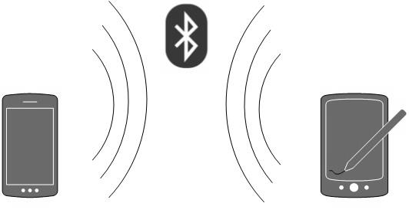
Types of Computer Networks
Personal Area Network (PAN):
PAN may take up eight devices in a master-slave fashion.

Slide 14
Types of Computer Networks
Local Area Network (LAN):
LAN is a computer network that covers inside a building and operated under a single administrative system.
LAN covers an organisation’s offices, colleges or universities.
The number of systems connected in LAN may vary from two to as much as 16 million.

Slide 15
Types of Computer Networks
Local Area Network (LAN):
LAN provides a useful way of sharing resources between end users.
These resources include: printers, scanners, and the internet that are sharable among computers.
LANs are composed of networking and routing equipments such as hubs, switches and routers.
A LAN may contain local servers serving file storage and other locally shared applications.

Slide 16
Types of Computer Networks
Local Area Network (LAN):
A LAN mostly operates on private IP addresses and does not involve heavy routing.
LAN works under a local domain and controlled centrally.
LAN uses either Ethernet or Token-ring technology.
Ethernet is the mostly widely employed LAN technology.
A LAN can be wired, wireless or in both form at any time.

Slide 17
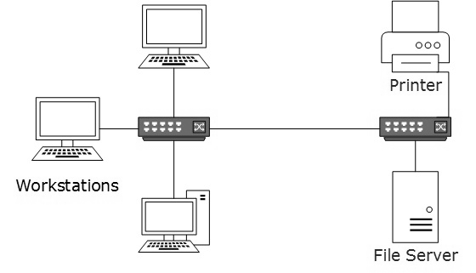
Types of Computer Networks

Slide 18
Types of Computer Networks
Metropolitan Area Network (MAN):
MAN is a computer network that covers an entire city, such as cable TV networks.
MAN can use Ethernet, Token-ring, Asynchronous Transfer Mode (ATM), or Fiber Distributed Data Interface (FDDI)
Metro Ethernet is a service provided by ISPs.
This service enables users to expand their LANs.
For example, MAN can help an organisation to connect all of its offices in a city.

Slide 19
Types of Computer Networks
Metropolitan Area Network (MAN):
The backbone of a MAN is a high-capacity and high-speed fiber optics.
MAN works in between LAN and Wide Area Network (WAN).
MAN provides the uplink for LANs to WANs or internet.

Slide 20
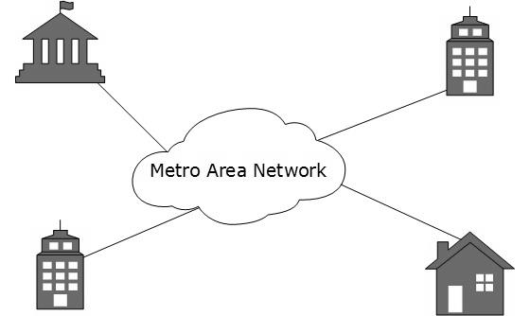
Types of Computer Networks

Slide 21
Types of Computer Networks
Wide Area Network (WAN):
WAN covers a large area which may be a province or a country.
Telecommunication networks are WANs.
These networks provide connectivity to MANs and LANs.
WANS are equipped with high speed backbone.
WAN may use advanced technologies such as Asynchronous Transfer Mode (ATM), Frame Relay, and Synchronous Optical Network (SONET).
WAN may be managed by multiple administration.

Slide 22
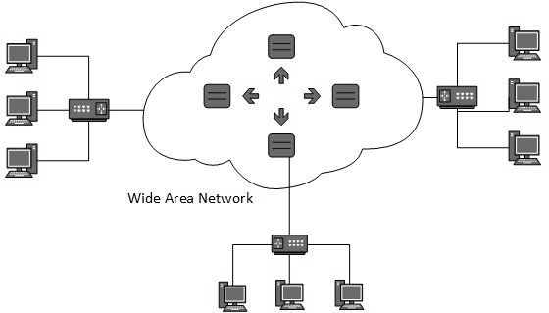
Types of Computer Networks

Slide 23
Types of Computer Networks
Internetwork:
Internetwork is the network of networks and simply referred to as Internet.
The internet is the largest network on the planet.
It connects all WANs thus bringing connections to homes and offices AKA LANs.
The Internet uses TCP/IP protocol suite and uses IP as the addressing protocol.

Slide 24
Types of Computer Networks
Internetwork:
The internet allows users to share and access enormous amount of information using World Wide Web (WWW), FTP, email services, audio and video streaming services and a host of others.
The internet is based on the client-server architecture.
Internet uses high speed fiber optics backbone as the medium of transmission.

Slide 25
Types of Computer Networks
Internetwork:
To inter-connect the various continents, fiber optic cables are laid under the sea and referred to as “submarine communication cables”.
Internet is widely deployed on the WWW services using HTML linked pages and accessible by client software known as the Web Browsers.

Slide 26
Types of Computer Networks
Internetwork:
The internet serves many purposes and is involved in many aspects of our lives such as:
Web sites
E-mail
Instant messaging
Blogging
Social Media
Marketing
Networking
Resource sharing
Audio and Video streaming.

Slide 27
LAN Technologies
Ethernet:
Ethernet is a standard networking architecture that defines the physical layout, lengths, and types of media that can be used. There are many variations of Ethernet but the most used is the CSMA/CD network access method.
The Ethernet technology is a widely deployed LAN.
Ethernet was invented in 1970 by Bob Metcalfe and D. R. Boggs.
It was then standardised in the IEEE 802.3 in 1980. This is why it mostly known as the 802.3 LAN.

Slide 28
LAN Technologies
Ethernet:
Ethernet uses the 10BASE-T specification.
Here, 10 stands for 10Mbps, BASE translates to baseband and T is for Thick Ethernet.
Ethernet technologies provide speed up to 10Mbps using Cat-5 cable.
Some of these technologies include:

Slide 29
LAN Technologies
Ethernet:
Fast-Ethernet
Fast-Ethernet emerged as a result of the growth in emerging technologies.
The technology was introduced in 1995.
This technology runs on UTP, optical fiber and wireless medium.
Fast-Ethernet offers speed up to 100Mbps.
By standardisation, the technology is referred to as the 100BASE-T in the IEEE 803.2 and uses mostly twisted pair cables.
On fiber optics cables, fast Ethernet goes up to 100 meters in half duplex mode and a maximum of 2000 meters in full-duplex multimode fibers.

Slide 30
LAN Technologies
Ethernet:
Giga-Ethernet
Giga-Ethernet provides speed up to 1000 Mbps.
In the IEEE standard, it is known as the IEEE802.3ab using Cat-5 UTP while IEEE802.3ah represents Giga-Ethernet over fiber.

Slide 31
Network Topologies
A network topology is the arrangement in which network devices and user devices are connected.
Topology may define both physical and logical aspect of the network.
Both logical and physical topologies could be same or different in the same network.
Network topologies include:

Slide 32
Network Topologies
Point-to-Point
In point-to-point networks, two host are directly connected to each other.
These host could be computers, switches, routers, or servers that are connected back to back using a single cable.
In any case, the receiving end is connected to the sending end or vice versa. If the he hosts are connected point-to-point logically, then they may have multiple intermediate devices.
In logical connections, the end hosts are unaware of the underlying network and see each other as though they are directly connected.

Slide 33

Network Topologies
Point-to-Point

Slide 34
Network Topologies
Bus Topology
In bus topology, all the devices share a single communication line/cable.
CSMA/CD technology is essential to bus topology because multiple hosts may send data at the same time.
Other than CSMA/CD, the hosts on the network may recognise one host as the bus master.
This topology is a simple form of networking in which the failure of a device does not affect the others.
However, failure of the shared medium affects the all the devices.
Both ends of the shared medium have a line terminator.
Data sent in only one direction and gets terminated when it reaches the extreme end.

Slide 35
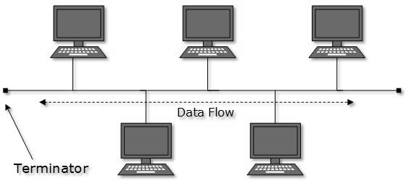
Network Topologies
Bus Topology

Slide 36
Network Topologies
Star Topology
In this topology, all the hosts are connected to a central device known as the hub.
Host to hub connection is achieved using a point-to-connection.
The hub device can be a:
Layer 1 device such as a hub or a repeater.
Layer-2 device such as a switch or a bridge.
Layer-3 device such as a router or a gateway.

Slide 37
Network Topologies
Star Topology
In this topology, the hub is a single point of failure.
If the hub fails, connectivity fails, consequentially.
Communication between hosts takes place through the hub.

Slide 38
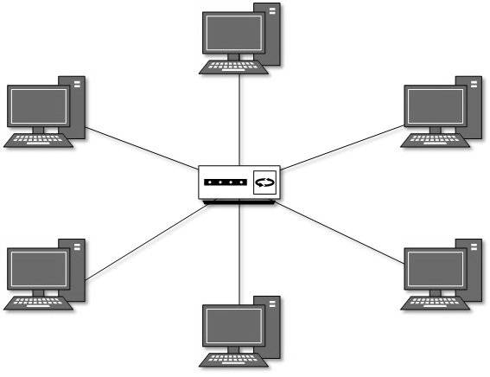
Network Topologies
Star Topology

Slide 39
Network Topologies
Ring Topology
In this topology, each system connects exactly to other system to create a circular structure.
When a system communicates to another, the data goes through all intermediate systems.
Connecting a new system in this topology requires just one cable.
A failure of one host results in the failure of the entire network.
However, a backup ring may be implemented to counter such failure.

Slide 40
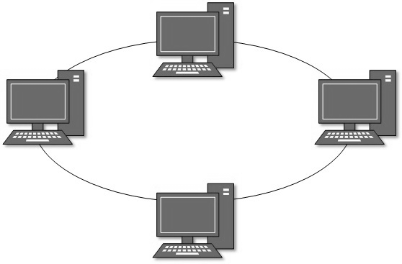
Network Topologies
Ring Topology

Slide 41
Network Topologies
Mesh Topology
In mesh topology, a host is connected to one or multiple hosts.
The topology utilises point-to-point connection to connect hosts.
Hosts in mesh topology may work as relay for other hosts which do not have direct point-to-point links.
Mesh topology includes:
Full Mesh:
All hosts have a point-to-point connection to every other host in the network.
For every new host, n(n-1)/2 connections are required.
This topology provides the most reliable network structure among all network topologies.

Slide 42
Network Topologies
Mesh Topology
Partially Mesh:
In partially mesh topology, some hosts do not have a point-to-point connection to every other host.
Hosts connect to each other in some arbitrarily fashion.
This topology exists where there is need to provide reliability to some hosts out of all.

Slide 43
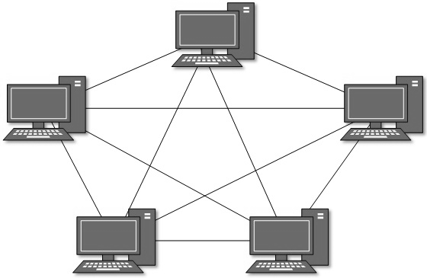
Network Topologies
Mesh Topology

Slide 44
Network Topologies
Tree/Hierarchical Topology
This is the most common form of network today.
The topology imitates as extended star topology with inherited properties of the bus topology.
This topology divides the network into multiple levels/layers of network.
In LANs, this topology categorises network devices into three types:
The lowermost is the access layer where computers are attached.
The middle layer is referred to as the distribution layer and works the mediator between the upper and lower layers.
The topmost layer is the core layer, and the central point of the network, i.e. root of the three from which all nodes forks out.

Slide 45
Network Topologies
Tree/Hierarchical Topology
In this topology, all neighboring hosts have a point-to-point connection between them.
Just as in bus topology, if the root goes down, the entire network suffers even though it is not a single point of failure.
Every connection serves as a point of failure. If the connection fails, it divides the network into unreachable segments.

Slide 46
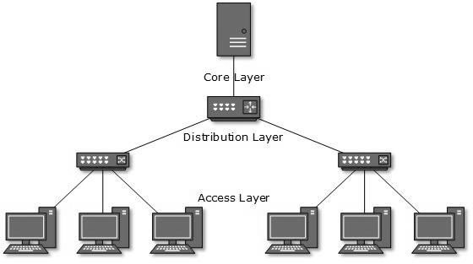
Network Topologies
Tree/Hierarchical Topology

Slide 47
Network Topologies
Daisy Chain Topology
Daisy chain topology connects all the host in a linear fashion.
Just like in ring topology, all hosts are connected to two hosts only except the end hosts.
Each link represents a single point of failure.
Every link failure splits the network into two segments.
An intermediate host works as relay for its immediate hosts.

Slide 48

Network Topologies
Daisy Chain Topology

Slide 49
Network Topologies
Hybrid Topology
Hybrid is a network whose design contains more than one topology.
It inherits the merits and demerits of all the incorporating topologies.
The combining topologies may contain attributes of the different topologies.
Most WANs are connected by means of dual-Ring topology and networks connected to them are star topology networks.
The entire Internet depicts the largest hybrid topology.

Slide 50
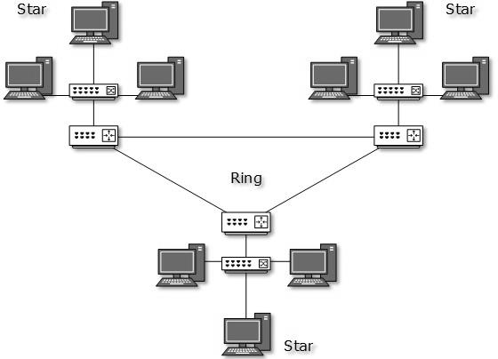
Network Topologies
Hybrid Topology

Slide 51
Network Models
Network engineering is a complicated task that involves software, firmware, chip level engineering, hardware and electric pulses.
To ease network engineering, the whole networking concept is divided into multiple layers.
Each layer is involved in some particular task and is independent of all other layers.
However, almost all networking tasks depend on all layers.
Layers share data between them and the depend on each other only to take input and send output.
In layered architecture of network model, one whole network process is divided into small tasks.
Each small task is then assigned to a particular layer which works dedicatedly to process the task.
Every layer does only specific work.

Slide 52
Network Models
In a layered communication system, one layer of a host deals with the task done by or to be done by its peer layer at the same level on the remote host.
The task is either initiated by layer at the lowest level or the one at the top most level.
If the task is initiated by the topmost layer, it is passed on to the layer below it for further processing.
The lower layer does the same thing. It processes the task and passes on to lower layer.
Every layer clubs together all procedures, protocols, and methods which it requires to execute its piece of task.
All layers identify their counterparts by means of encapsulation header and tail.

Slide 53
Network Models
Open System Interconnect (OSI) Model
The OSI is an open standard for all communications systems.
OSI model is established by the International Standard Organisation.
The OSI model has seven layers:

Slide 54
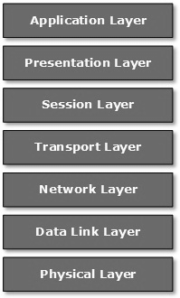
Network Models
Open System Interconnect (OSI) Model

Slide 55
Network Models
Open System Interconnect (OSI) Model
Application Layer:
This layer is responsible for providing interface to the application user.
The layer encompasses protocols which directly interact with the user.
Presentation Layer:
This layer defines how data in the native format of a remote host should be presented in the format of the receiving host.

Slide 56
Network Models
Open System Interconnect (OSI) Model
Session Layer:
The session layer maintains sessions between remote hosts.
For example, once user/password authentication is done, the remote host maintain this session for a while and does not ask for authentication again in that time span.
Transport Layer:
The transport layer is responsible for end-to-end delivery between hosts.
Network Layer:
Network layer performs address assignment and uniquely addressing hosts in a network.

Slide 57
Network Models
Open System Interconnect (OSI) Model
Data Link Layer:
The data link layer is responsible for reading and writing data from and onto the line.
Link errors are also detected on this layer.
Physical Layer:
This layer defines the hardware, cabling, wiring, power output, pulse rate, etc.

Slide 58
Network Models
Internet Model:
The Internet uses Transmission Control Protocol (TCP) and Internet Protocol (IP) protocol suite also known as the Internet suite.
The TCP/IP protocol suite defines the Internet Model which contains four layered architecture.
In spite of the OSI model, the Internet Model is model used for communications on the internet.
The internet is independent of its underlying network architecture just like its model.

Slide 59
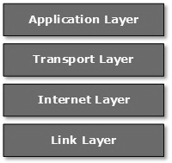
Network Models
Internet Model:

Slide 60
Network Models
Internet Model:
Application Layer
This layer defines the protocols which enables users to interact with the network.
These protocols include FTP, HTTP, etc.
Transport Layer
This layer ensures data flow between hosts.
The major protocol on this layer is the TCP.
This layer ensures that data delivered between hosts are in order.
The transport layer is responsible for end-to-end delivery.

Slide 61
Network Models
Internet Model:
Internet Layer
This is originally the network layer of the OSI model and sometimes referred to as the Layer Three.
This layer facilitates host addressing and recognition.
The IP protocol works on this layer.
The Internet layer defines routing in the throughout the entire network.
Link Layer
The link layer provides the mechanism for sending and receiving data on the network.
Unlike its counterpart in the OSI model, this layer is independent of the underlying network architecture and hardware.

Slide 62
Physical Layer
The physical layer interfaces the hardware and the signalling mechanism.
This is the only layer of the OSI model that handles connectivity for all connected devices,
The physical layer defines the hardware equipment, cabling, wiring, frequencies, pulses used to binary signals, etc.
This layer provides services to the data-link layer.
The physical layer converts frames from the data-link layer into electrical pulses (binary data).
The binary data is then sent over the wired or wireless media.

Slide 63
Physical Layer
Signals
Signal is an electrical pulse that moves through a wire in the form of voltage.
When data is sent over a physical medium, it is first converted into electromagnetic signals.
The data itself can be analog such as the human voice, or digital such as a file on a computer.
Both analog and digital data can be represented in digital or analog signals.
Digital signals are discrete in nature and represent a sequence of voltage pulses.
Digital signals are used within the circuitry of the computer.
Analog signals are in continuous wave form in nature and represented by continuous electromagnetic waves.

Slide 64
Physical Layer
Signal
When a signal travels through the medium, it tends to deteriorate. This may be as a result of factors such as:
Attenuation
For a receiver to interpret the data accurately, the signal must be sufficiently strong.
When the signal passes through the medium, it tends to get weaker.
As it covers longer distance, it loses strength.
Dispersion
As signal travels through the media, it tends to spread and overlap.
The amount of dispersion depends on the frequency been used.
Delay Distortion
Signals are sent on a medium with predefined speed and frequency.
If the signal speed and frequency do not match, there are possibilities that the signal reaches destination in arbitrary fashion.
In digital media, it is very critical that some bits reach earlier than the previously sent ones.

Slide 65
Physical Layer
Signal
Noise
Noise is a random disturbance or fluctuation in analog or digital signal.
Noise may distort the original information in transmission.
Noise is characterised as follows:
Thermal Noise
heat agitates the electronic conductors of a medium thereby introducing noise to the media.
To a great extent, thermal noise is unavoidable.
Intermodulation
When multiple frequencies share a medium, their interference can cause noise in the medium.
Intermodulation noise occurs if two different frequencies share a medium and one of them has excessive strength or the component itself is not functioning properly, then the resultant frequency may not be delivered as expected.
Crosstalk
Crosstalk happens when a foreign signal enters into the media.
This is because the signal in one medium affects the signal of the second medium.
Impulse
This occurs because of irregular disturbances such lightening, electricity, short-circuit or faulty component.

Slide 66
Physical Layer
Transmission Media
This is the physical media over which information is sent between two connected devices.
There are two forms of transmission media:
Guided Media
In guided media, the sender and the receiver are directly connected and the information is sent (guided) through the media.
All communication wires/cables such as UTP, coaxial cables, and fiber optics are guided media.
Unguided Media
In unguided media, there is no connectivity between the sender an the receiver.
Information is spread the air and anyone including the recipient may collect the information.
Wireless/open air space is an unguided media.

Slide 67
Physical Layer
Transmission Media
There are different types transmission media:
Magnetic Media
This form of transmission existed long before the concept of networking but it now old fashion.
Information is saved on a physical media then physically moved from one station to another.
Even though it is old fashion, it still plays huge role in data backup in the business communities today.
It saves money when huge amount of data needs to be transferred.
Twisted Pair Cable
A twisted pair cable is made of two plastic insulated copper wires twisted together to form a single media.
One of the two wires only carries the actual signal while the other is used for ground reference.
The twists between wires help to reduce noise (electromagnetic interference) and crosstalk.

Slide 68
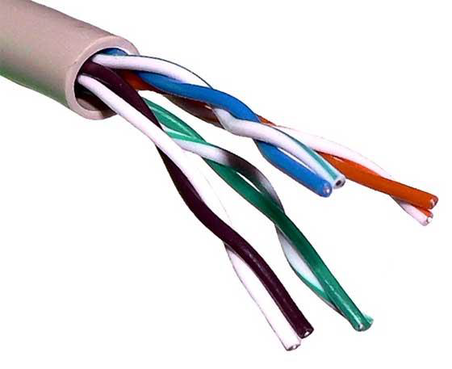
Physical Layer
Transmission Media
Twisted Pair Cable
There are two types of twisted pair cables:
Shielded Twisted Pair (STP) Cables
These cables are covered in metal foil therefore indifferent to noise and crosstalk.
Unshielded Twisted Pair (UTP) Cables
These are unlike the STP.
UTP cables are most used twisted pair in computer networks.
UTP has seven categories, each suitable for specific use: Cat-5, Cat-5e and Cat-6 are mostly used today to render a high speed internet.
UTP cables are connected using RJ45.

Slide 69
Physical Layer
Transmission Media
Coaxial Cable
Coaxial cables has two wires of copper.
The core wire lies in the center and it is made of solid conductor.
The core is enclosed in an insulating sheath.
The second wire is wrapped around over the sheath and also encased by an insulator sheath.
All of these are then covered by plastic cover.
Due to its strength, the coaxial cable is capable of carrying high frequency signals than the twisted pair cables.
The wrapped structure provides it a good shield against noise and crosstalk.
Coaxial cables provide bandwidth rates up to 450Mbps.
Coaxial cables are connected using BNC and BNC-T connector.
A BNC terminator is used to terminate the wire at the far end.
Coaxial Cables are categorised into three:
RG-59 used for TV transmission.
RG-58 used in Thin Ethernet.
RG-11 used in Thick Ethernet.
RG stands for Radio Government.

Slide 70
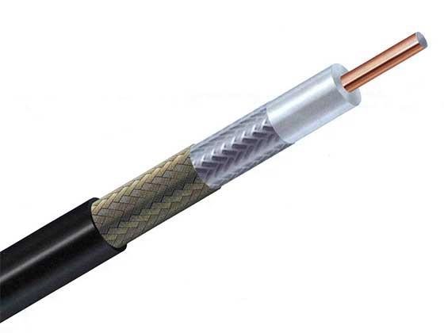
Physical Layer

Slide 71
Physical Layer
Transmission Media
Power Lines
Power Line Communication (PLC) is a Layer-1 technology which uses power cables to transmit data signals.
In PLC, modulated data is sent over the cables.
The receiver on the other end demodulates and interprets the data.
Because power lines are widely deployed, PLC can make all powered devices controlled and monitored.
PLC works in half duplex.
There are two types of PLC:
Narrow band PLC
Narrow band PLC provides lower data rates up to 100s of kbps because they work in lower frequencies.
Narrow band PLC can be spread over several kilometres.
Broad band PLC
Broad band PLC provides higher data rates up to 100s of Mbps.
Broad band PLC work at higher frequencies (1.8 – 250 MHz).

Slide 72
Physical Layer
Transmission Media
Fiber Optics
Fiber optics works on the properties of light.
When light ray hits at the critical angle, it tends to refract at 90 degrees.
This property is what fiber optics employs.
From one end, light is emitted and travels through it then it is detected at the other end using light detector.
The light detector detects light stream and converts them into to electrical data.
Fiber optics provides the highest mode of speed.
Fiber optics comes in two modes: single and multi mode.
Single mode carries a single ray of light whereas the multimode carries multiple beams of light.
Fiber optics also comes in unidirectional and bidirectional capabilities.
Fiber optic cables are connected using special connectors: Subscriber Channel (SC), Straight Tip (ST) or MT-RJ

Slide 73
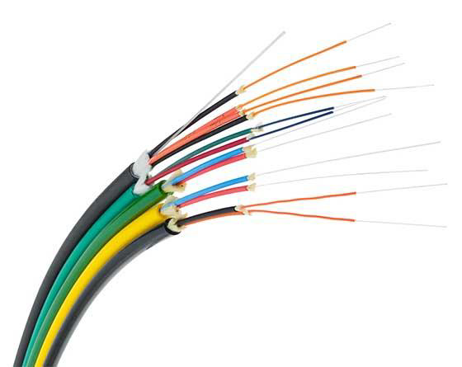
Physical Layer

Slide 74
Physical Layer
Transmission Media
Wireless
Wireless transmission is a form of unguided media.
In the wireless environment, communication involves no physical link established between two or more devices.
Wireless signals are spread over the air and are received and interpreted by appropriate antenna.
When an antenna is attached to electrical circuit of a computer or wireless device, it converts the digital data into wireless signals and spread all over within its frequency range.
The receiver on the other end receives these signals and converts them back to digital data.

Slide 75
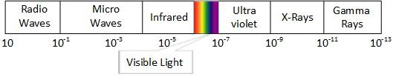
Physical Layer
Transmission Media
Wireless
A little part of electromagnetic spectrum is used for wireless transmission.

Slide 76
Physical Layer
Transmission Media
Wireless
The different wireless transmission media include:
Radio Transmission
Microwave Transmission
Infrared Transmission
Light Transmission

Slide 77
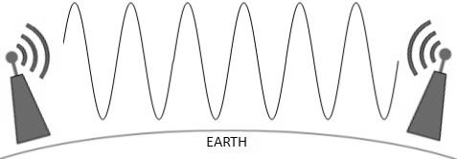
Physical Layer
Transmission Media
Wireless
Radio Transmission
Lower frequencies such as VLF, LF and MF bands can travel on the ground up to 1000 kilometers over the earth surface.

Slide 78
Transmission Media
Wireless
Radio Transmission
Radio frequency is easier to generate and because of its large wavelength it can penetrate through walls and structures alike.
Radio waves can have wavelength from 1mm to 100,000km.
Radio waves also have frequency ranging from 3Hz (extremely low frequency) to 300GHz (extremely high frequency).
Radio frequencies are sub-divided into six bands
Radio waves lower frequencies can travel through walls where higher RF can travel in straight line and bounce back.
High frequency radio waves have more power.
The power of low frequency waves decreases sharply as they cover long distances.

Slide 79
Physical Layer
Transmission Media
Wireless
Radio Transmission
Radio waves of high frequencies are open to be absorbed by rain and other obstacles.
These radio waves use Ionosphere of the earth’s atmosphere.
High frequency radio waves such as HF and VHF bands are spread upwards.
When they reach the Ionosphere, they are refracted back to earth.

Slide 80
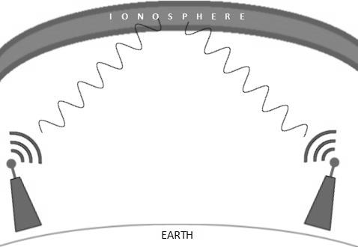
Physical Layer
Transmission Media
Wireless
Radio Transmission

Slide 81
Physical Layer
Transmission Media
Wireless
Microwave Transmission
Electromagnetic waves above 100MHz tend to travel in a straight line and signals over them can be sent by beaming those waves towards one particular station.
Since microwaves travel in straight lines, both sender and receiver must align in strictly line-of-sight fashion.
Microwaves have wavelength ranging from 1mm to 1m and frequencies between 300MHz and 300GHz.
Microwave antennae concentrate the waves making a beam of it.
As shown in the figure on the next slide, multiple antennae can be aligned to reach further.
Microwave have higher frequencies and do not penetrate wall like obstacles.
Microwave transmission depends highly upon weather conditions and the frequency it is using.

Slide 82
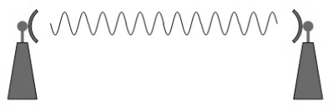
Physical Layer
Transmission Media
Wireless
Microwave Transmission

Slide 83
Physical Layer
Transmission Media
Wireless
Infrared Transmission
Infrared wave lies between visible light spectrum and microwaves.
Infrared has wavelength of 700nm to 1mm and frequency range of 300GHz to 430THz.
Infrared wave is used for very short range communication purposes such as television remotes.
Infrared travels in a straight line, hence it is directional by nature.
Due to the high frequency, infrared cannot go through wall-like obstacles.

Slide 84
Physical Layer
Transmission Media
Wireless
Light Transmission
Light transmission is realised using LASER.
LASER is the highest most electromagnetic spectrum which can be used for data transmission which done through light or optical signalling.
Because of its high frequency, it tends to travels strictly in straight line.
Because LASER transmission is unidirectional, at both ends of the communication, there is need to install a photo-detector.
LASER beam is generally 1mm wide therefore making it a work of precision to align two far receptors each pointing to a LASER source.

Slide 85
Physical Layer
Transmission Media
Wireless
Light Transmission
LASER cannot penetrate obstacles such as walls, rain, and thick fog.
LASER beam is distorted by wind, atmosphere temperature, or a variation in temperature in the path.
LASER is safe for data transmission as it is very difficult to tap 1mm wide laser without interrupting the communication channel.
As shown in the figure on the next slide, LASER works as the transmitter (Tx) and the photo-detector works as the receiver (Rx).

Slide 86
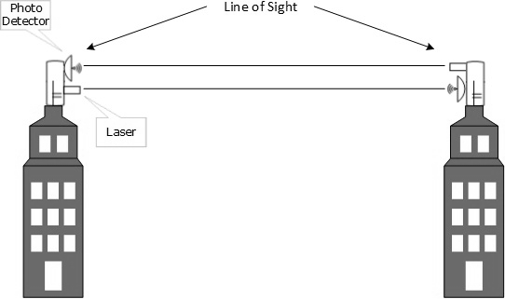
Physical Layer
Transmission Media
Wireless
Light Transmission

Slide 87
Physical Layer
Digital Transmission
Data/information is stored in either of ways: analog or digital.
For a computer to use data, it must be in discrete digital form.
Similar to data, signals can also be in analog or digital form.
To transmit data digitally, it needs to be converted to digital form.

Slide 88
Physical Layer
Digital Transmission
Digital-to-Digital Conversion
To be able transmit digital data through a network, it needs to be converted into a digital signal.
This conversion can be done in two ways: line coding and block coding.
Line coding is necessary for all communication whereas block coding is optional.

Slide 89
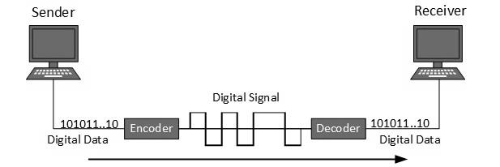
Physical Layer
Digital Transmission
Digital-to-Digital Conversion
Line Coding
Line coding is the process used to convert digital data into digital signal.
Digital data is found in binary format.
This data is represented (stored) internally as a series of 1s and 0s.
The figure below shows what happens when this data is exchanged between two devices.

Slide 90
Physical Layer
Digital Transmission
Digital-to-Digital Conversion
Line Coding
Digital signal is denoted by discrete signal which represents digital data.
There are three types of line coding schemes. These include: unipolar, polar and bipolar.

Slide 91
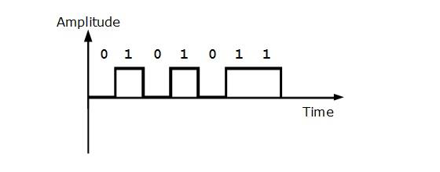
Physical Layer
Digital Transmission
Digital-to-Digital Conversion
Line Coding
Unipolar
Unipolar encoding scheme use single voltage level to represent data.
High voltage is transmitted to represent 1 while 0 is represented by no voltage.
This scheme is also called the Unipolar-Non-return-to-zero because there is no rest condition i.e., it either represents 1 or 0.

Slide 92
Physical Layer
Digital Transmission
Digital-to-Digital Conversion
Line Coding
Polar Encoding
Polar encoding scheme uses multiple voltage levels to represent binary values.
Polar encoding is available in four types:
Polar Non Return to Zero (Polar NRZ)
Return to Zero (RZ)
Manchester
Differential Manchester

Slide 93
Physical Layer
Digital Transmission
Digital-to-Digital Conversion
Line Coding
Polar Encoding
Polar Non Return to Zero (Polar NRZ)
Polar NRZ uses two different voltage to represent binary values.
Positive voltage represents 1 and negative value represents 0.
It is also called NRZ because there is not rest condition.
NRZ scheme has two variants, the NRZ-L and NRZ-I
NRZ-L changes voltage level when a different bit is encountered.
In NRZ-I, when 1 is encountered, the voltage changes.

Slide 94
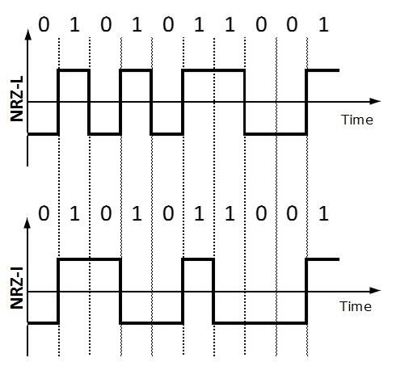
Physical Layer
Digital Transmission
Digital-to-Digital Conversion
Line Coding
Polar Encoding
Polar Non Return to Zero (Polar NRZ)

Slide 95
Physical Layer
Digital Transmission
Digital-to-Digital Conversion
Line Coding
Polar Encoding
Return to Zero (RZ)
The RZ encoding scheme uses three voltage level: positive voltage to represent 1, negative voltage to represent 0 and zero voltage for none.
The problem with RZ is that the receiver cannot conclude when a bit ended and when the next bit is started.

Slide 96
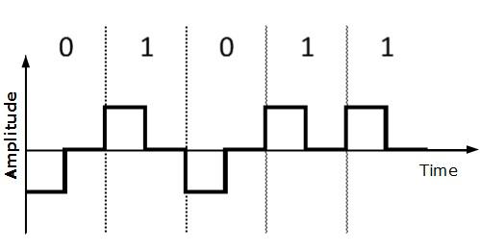
Physical Layer
Digital Transmission
Digital-to-Digital Conversion
Line Coding
Polar Encoding
Return to Zero (RZ)

Slide 97
Physical Layer
Digital Transmission
Digital-to-Digital Conversion
Line Coding
Polar Encoding
Manchester
This encoding scheme is a combination of RZ and NRZ-L.
Bit time is divided into two halves.
It transits in the middle of the bit and changes phase when different bit is encountered.
Differential Manchester
Just like Manchester, this scheme is a combination of RZ and NRZ-I.
It also transits at the middle of the bit but changes phase only when 1 is encountered.

Slide 98
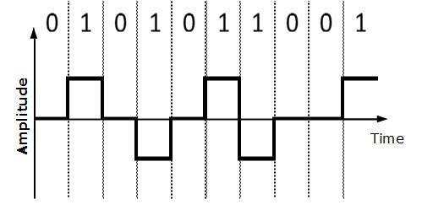
Physical Layer
Digital Transmission
Digital-to-Digital Conversion
Line Coding
Bipolar Encoding
Bipolar encoding uses three voltage levels: positive, negative and zero.
Zero represents binary 0 and 1 is represented by altering positive and negative voltage.

Slide 99
Physical Layer
Digital Transmission
Digital-to-Digital Conversion
Block Coding
Block coding uses redundant bits to ensure the accuracy of received data frame.
For example, in even-parity, one parity bit is added to make the count of 1s in the frame even.
This way, the original number of bits is increased.
Block coding is represented by slash notation, mB/nB. This notation means that m-bit block is substituted with n-bit block where n>m.
Block coding involves three steps:
Division
Substitution
Combination
After block coding is done, it is line coded for transmission.

Slide 100
Physical Layer
Digital Transmission
Analog-to-Digital Conversion
The natural world is mostly surrounded in analog data.
For example, microphones create voice and cameras produce videos which are analog data.
To transmit this data over digital signals, there is need to perform analog to digital conversion.
Analog Data is a continuous stream of data in the wave form whereas digital data is discrete.
To convert analog wave into digital data, Pulse Code Modulation (PCM) is used.

Slide 101
Physical Layer
Digital Transmission
Analog-to-Digital Conversion
PCM is one of the most commonly used method to convert analog data into digital form.
PCM uses three steps to achieve the conversion:
Sampling
Quantisation
Encoding

Slide 102
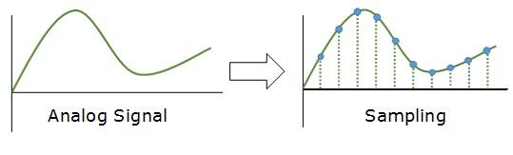
Physical Layer
Digital Transmission
Analog-to-Digital Conversion
Sampling
Sampling yields discrete form of continuous analog signal.
The analog signal is sampled every T interval.
The most important factor in sampling is the rate at which the analog signal is sampled.
According to Nyquist Theorem, the sampling rate must be at least two times the highest frequency of the signal.

Slide 103
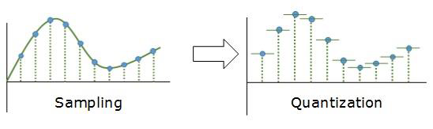
Physical Layer
Digital Transmission
Analog-to-Digital Conversion
Quantisation
As stated earlier, sampling yields discrete form of analog signal.
Every discrete pattern shown the amplitude of the analog signal at that instance.
Quantisation is done between the maximum amplitude value and the minimum amplitude value.
Quantisation is an approximation of the instantaneous analog value.

Slide 104
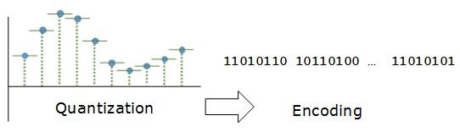
Physical Layer
Digital Transmission
Analog-to-Digital Conversion
Encoding
In encoding, each approximated value is then converted into binary format.

Slide 105
Physical Layer
Digital Transmission
Transmission Mode
Transmission mode decides how data is transmitted between two devices.
The binary data in the form of 1s and 0s can be sent in two different modes: parallel and serial transmission modes.

Slide 106
Physical Layer
Digital Transmission
Transmission Mode
Parallel Transmission
In parallel transmission, the binary bits are organised into groups of fixed lengths.
Both sender and receiver are connected in parallel with the equal number of data lines.
Both computers distinguish between high order and low order data lines.
The sender sends all the bits at once on all lines.
Because the data lines are equal to the number of bits in a group, or data frame, a complete group of bits (data frame) is sent in one go.
Parallel transmission has speed as an advantage.
However, the disadvantage is the cost of wires, as it equals to the number of bits sent in parallel.

Slide 107
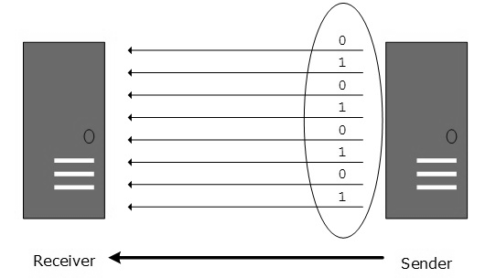
Digital Transmission
Transmission Mode
Parallel Transmission

Slide 108
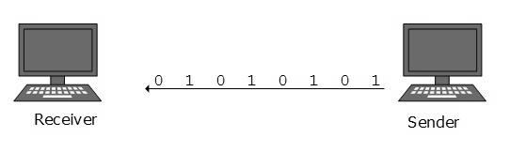
Physical Layer
Digital Transmission
Transmission Mode
Serial Transmission
In serial transmission, bits are sent one after another in a queue.
Serial transmission requires only one transmission line.
Serial transmission can either be asynchronous or synchronous.

Slide 109
Physical Layer
Digital Transmission
Transmission Mode
Serial Transmission
Asynchronous Serial Transmission
This transmission is asynchronous because there is no importance of timing.
Data bits have specific pattern and they help the receiver recognise the start and the end of the data bits.
0 is prefixed on every data and 1 or more 1s are added at the end.
Two continuous data frames (bytes) may have a gap between them.

Slide 110
Physical Layer
Digital Transmission
Transmission Mode
Serial Transmission
Synchronous Serial Transmission
This method of transmission is synchronous because timing is required since there is no mechanism to recognise the start and end data bits.
There is no pattern or prefix/suffix method.
Data bits are sent in burst mode without maintaining gap between bytes (8-bits).
Single burst of data may contain a number of bytes which makes timing very important.
It is up to the receiver to recognise and separate bits into bytes.
The advantage is high speed with no overhead of extra header and footer bits.

Slide 111
Physical Layer
Analog Transmission
To send digital data over an analog media, it needs to be converted into analog signal.
In converting digital data into analog signal, there can be two cases:
Bandpass:
In bandpass, filters are used to filter and pass frequencies of interest.
A bandpass is a band of frequencies which can pass the filter.
Low-pass:
Low-pass is a filter that passes low frequency signals.

Slide 112
Physical Layer
Analog Transmission
When digital data is converted into a bandpass analog signal, is called digital-to-analog conversion.
Same way, when low-pass analog signal is converted into bandpass analog signal, it is called analog-to-analog conversion.

Slide 113
Physical Layer
Analog Transmission
Digital-to-Analog Conversion
When data from one device is sent to another via some analog carrier, it is first converted int analog signals.
Analog signals are modified to reflect digital data.
An analog signal is characterised by its amplitude, frequency, and phase.

Slide 114
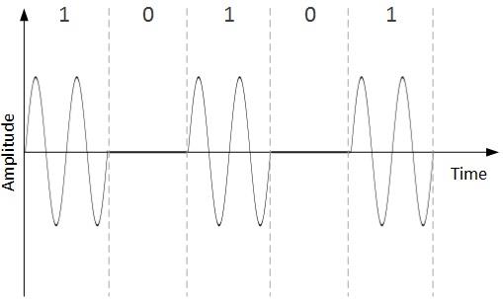
Physical Layer
Analog Transmission
Digital-to-Analog Conversion
There are three kinds of digital-to-analog conversion:
Amplitude Shift Keying (ASK)
In ASK conversion technique, the amplitude of the analog carrier signal is modified to reflect binary data.

Slide 115
Physical Layer
Analog Transmission
Digital-to-Analog Conversion
Amplitude Shift Keying (ASK)
Binary data represents digit 1, therefore the amplitude is held.
Otherwise, it is set to 0.

Slide 116
Physical Layer
Analog Transmission
Digital-to-Analog Conversion

Slide 117
Physical Layer

Slide 118
Physical Layer

Slide 119
Physical Layer

Slide 120
Physical Layer

